Slide 1
Basics of ABLE Accounts
Note: This presentation has been tailored for outreach to Black, Indigenous and other People of Color communities and reflects 2021 numbers on ABLE.
The ABLE National Resource Center is funded through a grant from Prudential.

Slide 2
The ABLE National Resource Center
The ABLE National Resource Center (ABLE NRC) is the leading, comprehensive source of objective, independent information about federal- and state-related ABLE programs and activities, including guidance on tax-advantaged ABLE savings accounts.
Our mission is to educate, promote and support the positive impact ABLE can make on the lives of millions of Americans with disabilities and their families.
Our pioneering work in this area and subject matter expertise makes us the foremost authority on topics related to the Achieving a Better Life Experience (ABLE) Act, ABLE accounts, state ABLE programs, ABLE-related policy developments and comprehensive integration of ABLE and financial capability strategies for people with disabilities into public service delivery systems.
ablenrc.org
Notes:
Miranda
The ABLE National Resource Center does not open ABLE accounts nor manage the State ABLE Programs.
Our mission is to educate, promote and support the positive impact an ABLE account can make on the lives of individuals with disabilities and their families.
If you cannot locate the answer to your question on our website or if the question is State-specific, please reach out to your State ABLE Program or to the State ABLE Program in which you are thinking about establishing your account. In the unlikely event that they cannot cannot answer your question, please ask them to contact us directly. It may involve a systemic problem that we are already working to solve!

Slide 3


Slide 4
What is an ABLE Account?

Slide 5
What Is an ABLE Account?
An ABLE account is a Section 529A savings and investment account owned by a person who has a physical/mental disability or blindness with an onset before age 26 and who also:
  Receives Supplemental Security Income (SSI) and/or Social Security Disability Insurance (SSDI) benefits,
  OR
  Does not receive SSI or SSDI benefits but has a written and signed disability certification from a licensed physician (MD or DO) that contains the diagnosis which indicates a physical/mental disability or blindness that results in “marked and severe functional limitations” which has lasted or can be expected to last for 12 months or more or result in death.
Notes:
Note: Bullet two is “priming the pump” to give you the option to throw out there the fact that we will have the state partnership programs conduct webinars in future months……so, stay tuned.

Slide 6
Why Should I save in an ABLE Account?

Slide 7
There are Extra Costs when Living with a Disability
Households containing an adult with a work-disability require, on average, 28% more income (or an additional $17,750 a year at the median household income) to obtain the same standard of living as a comparable household without a member with a disability;
An ABLE account can cover many of these extra expenses.
Source: Morris, McGarity, & Goodman published work: https://journals.sagepub.com/doi/10.1177/10442073211043521

Slide 8
Why Should I Save in an ABLE Account? (slide 2 of 5)
Resource Limits
ABLE savings up to $100,000 will NOT affect Supplemental Security Income (SSI) benefits or Medicare Part D “Extra Help”.
A person can have any amount of ABLE savings and it will NOT affect:
  Free Application for Federal Student Aid (FAFSA),
  Housing Assistance through Housing and Urban Development programs (HUD),
  Supplemental Nutrition and Assistance Program (SNAP),
  Social Security and Disability Insurance (SSDI), or
  Medicare (Entitlement to Parts A, B, C, or D) or Medicare Savings Programs, or
  Any type of Medicaid benefit including Medicaid waiver services.

Slide 9
Why Should I Save in an ABLE Account? (slide 3 of 5)
Supplementing Benefits
The funds in an ABLE account do not replace benefits provided by private insurance, FAFSA, HUD, Medicaid, Medicare, Social Security Disability Insurance, the beneficiary’s employment, SSA work supports, Vocational Rehabilitation, employment training and other sources.
ABLE savings can be used to supplement funding from those other sources, and it is a “best practice” to look to using those other sources and funds first – prior to using ABLE funds.

Slide 10
Why Should I Save in an ABLE Account? (slide 4 of 5)
ABLE account tax advantages:
  The account balance (principle and income) can be invested through a variety of options offered by an ABLE program;
  Interest growth is tax-free when used for QDEs;
  Contributions into ABLE from family, friends, a Special Needs or Pooled Trust or a 529 College Savings Plan rollover, do not count as income by federally funded means-tested benefit programs;
  The account owner, family, friends and others can contribute up to $15,000 per calendar year.
Notes:
Then turn it over to Marlene

Slide 11
Why Should I Save in an ABLE Account? (slide 5 of 5)
ABLE account tax advantages, continued:
  An ABLE account owner who works and does not participate in an employer sponsored retirement account may save up to an additional $12,760 within ABLE, from their earnings. For residents of Alaska, that is $15,950; residents of Hawaii, $14,680.
  State ABLE plans allow, over time, savings of up to $235,000 to $529,000.
Notes:
Then turn it over to Marlene

Slide 12
Countable Income:
An ABLE account is a protected savings account.
Examples of income saved from the following sources still counts as income - by means-tested benefit programs - even when deposited directly into an ABLE account:
  Earned income and self-employment income;
  Child support and maintenance;
  Unearned income such as alimony, unemployment compensation, worker’s compensation, pension, retirement benefits, 403b and 401k distributions, and veteran’s benefits.
SSDI benefits are not “means-tested” benefits.

Slide 13
How Do I Open an ABLE Account?

Slide 14
How Do I Open An ABLE Account?
ABLE accounts are predominantly opened online; contact the ABLE plan for alternatives.
The average amount of time it takes to complete the registration form to open an ABLE account online is less than ten minutes.
  ABLE programs require a person read the State ABLE disclosure document prior to opening an account. This takes time beyond that “ten minutes” and will provide important information about making savings choices in an ABLE program in addition to preparing to complete the online form.
Once the account is open, the account owner can grant others permission (revocable) to access various levels of information about the account and/or to take specified actions on the account.

Slide 15
What Purchases Can I Make Using My ABLE Account?

Slide 16
ABLE Qualified Disability Expenses (QDEs)
Education;
Basic living expenses including food and shelter;
Housing including utilities, rent, modification, purchase, property taxes;
Transportation;
Employment training and support;
Assistive technology;
Personal support services;
Health care expenses;
Legal fees and financial management;
Funeral and burial expenses.

Slide 17
ABLE can be used for COVID-19-Related Expenses
Personal protective equipment;
Delivery charges for food, prescriptions, and groceries;
Housing expenses for primary residence as well as expenses to stay in a hotel to shelter in place in a high risk situation;
Health care costs such as deductibles, copays or other charges or for private personal care or attendant services.
COVID-19 Specific Financial Information for People with Disabilities:
https://www.nationaldisabilityinstitute.org/financial-resilience-center/

Slide 18
Why is ABLE Especially Important for BIPOC Individuals and Families?

Slide 19
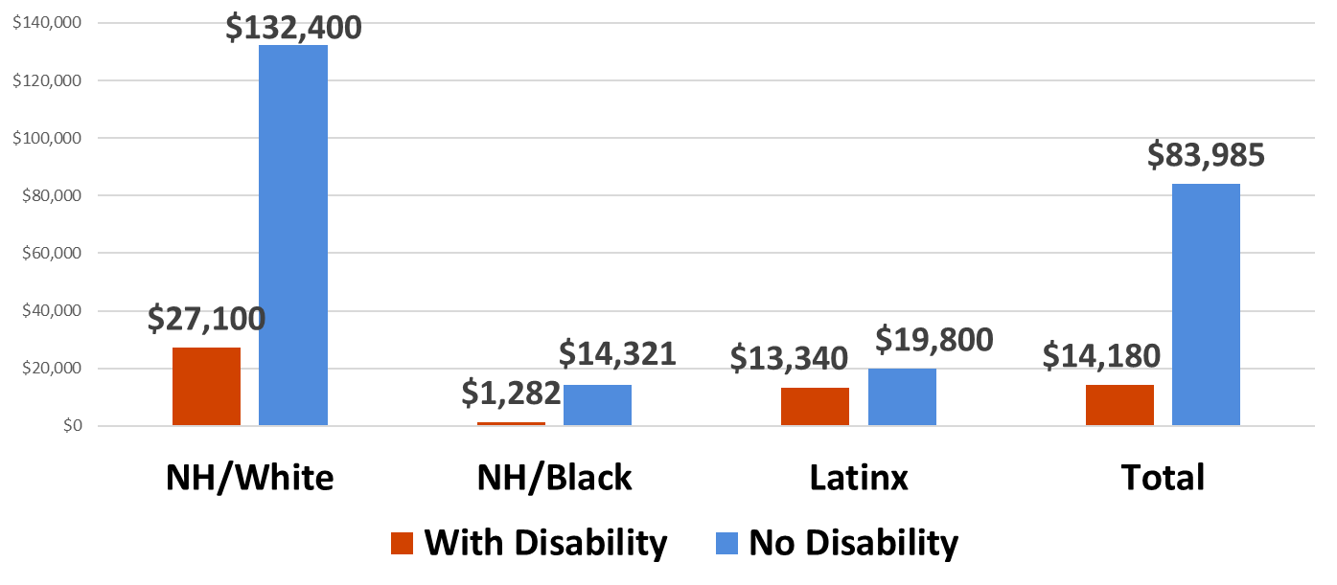
Across all racial/ethnic groups, households with a disabled working-age householder have lower net worth, compared to households without disability ($14,180 versus $83,985)
Households with householders who are Black and disabled have the lowest net worth ($1,282)
Source: NDI Analysis of U.S. Census Bureau (2019) Survey of Income and Program Participation Microdata, 2014 Panel, Wave 4

Slide 20
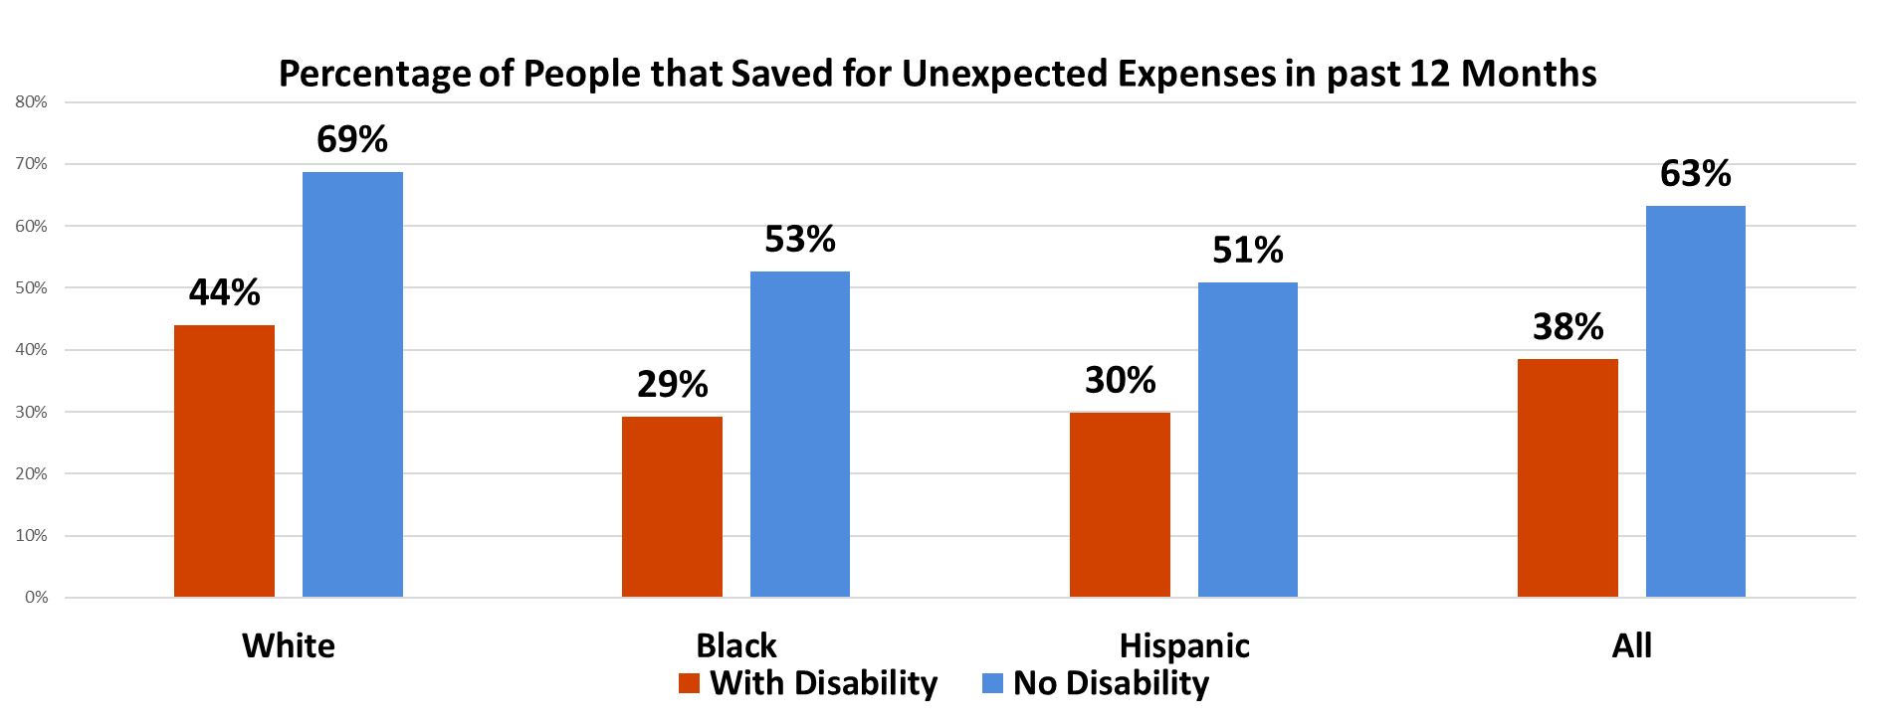
Across all racial/ethnic groups, a lower percentage of people with disabilities saved for
unexpected expenses, compared to people without disability.
Lower percentage of people with disabilities who are also Black and Hispanic saved for unexpected expenses, compared to those who have disabilities and are White
Source: Goodman, N. and Morris, M. (2019) Banking Status and Financial Behaviors of Adults with Disabilities. National Disability Institute

Slide 21
New Reports on Race, Ethnicity and Disability
“Race, Ethnicity and Disability: The Financial Impact of Systemic Inequality and Intersectionality” nationaldisabilityinstitute.org/reports/research-brief-race-ethnicity-and-disability/
“Disability, Race and Ethnicity: Factsheets and Infographics” nationaldisabilityinstitute.org/reports/disability-race-and-ethnicity-factsheets-and-infographics/

Slide 22
Statistics on ABLE Accounts

Slide 23
Where do ABLE Accounts Stand Now?
Eight million people with disabilities are eligible.
Third Quarter 2021 ABLE Statistics:
105,478 ABLE accounts
$937 million in assets in ABLE (529A) accounts
$8,883 average savings held in ABLE Accounts;

Slide 24
When Should I Open My ABLE ACCOUNT?

Slide 25
When Should I Open an ABLE Account? (slide 1 of 2)
As soon as possible to save and grow investments over time;
When a child is born with a significant disability;
While developing an Individual Education Plan (IEP) for a youth / transition plan;
When someone says “We need to spend down”;
When the $2,000 resource limit is holding you back from being able to save;

Slide 26
When Should I Open an ABLE Account? (slide 2 of 2)
When you:
are working;
are falling between the cracks and is not qualifying for services;
have family who would like to help out;
need Medicaid;
receive an inheritance or insurance settlement up to $15,000;
have a savings or spending goal;
have a disability and was never able to save for retirement.

Slide 27
ABLE Best Practices and Important Things to Keep in Mind

Slide 28
Best Practices for Your ABLE Account
SSI recipients: continue to use SSI first to pay for housing and food;
Pay for housing expenses the month the ABLE funds are withdrawn;
Identify and focus on the ABLE account owner’s savings goal;
Prepare a Spending Plan for all monthly expenses;
  What income will pay for each spending plan item?
  What money can be saved for the future ABLE QDE goal?

Slide 29
Possible Medicaid Payback
Upon the death of the ABLE account owner, Medicaid can choose to file a claim for Medicaid expenses paid since the ABLE account was opened;
If the ABLE account owner did not receive Medicaid, there is no payback;
If Medicaid Buy In premiums were paid, they are deducted before Medicaid payback;
Before Medicaid payback, the ABLE account can be used to repay any outstanding Qualified Disability Expenses, including funeral and burial costs;
Some ABLE plans have waived Medicaid payback for their state’s residents;
Any remaining balance will be distributed to the successor designated beneficiary or if none, to the account owner’s estate.
Notes:
Laurie

Slide 30
ABLE Resources

Slide 31
Check out the Full Range of Resources in the ABLE BIPOC Outreach Toolkit: ablenrc.org/bipoc-outreach-toolkit/

Slide 32
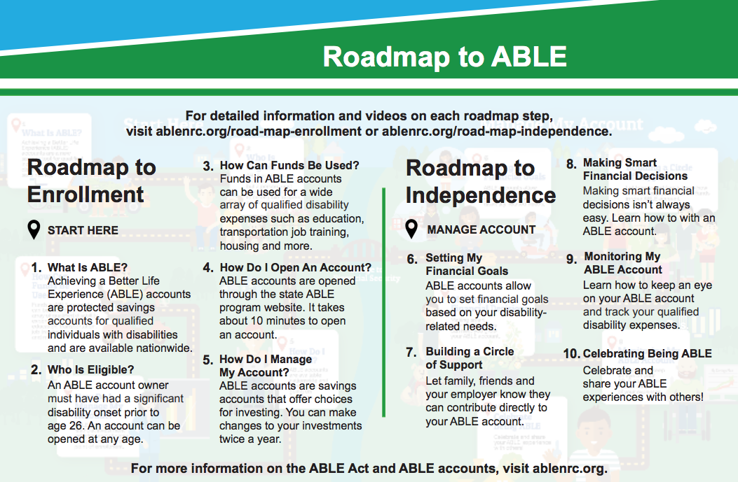
Roadmap to ABLE Enrollment: ablenrc.org/get-started/
Roadmap to Independence: ablenrc.org/manage-account/

Slide 33
ABLE Federal Guidance
IRS Final ABLE Regulations: https://www.federalregister.gov/documents/2020/11/19/2020-22144/guidance-under-section-529a-qualified-able-programs
Supplemental Security Income (SSI): secure.ssa.gov/apps10/poms.nsf/lnx/0501130740
Centers for Medicare and Medicaid Services (CMS): medicaid.gov/federal-policy-guidance/downloads/smd17002.pdf
    Supplemental Nutrition Assistance Program (SNAP): fns.usda.gov/snap/treatment-able-accounts-determining-snap-eligibility.
    Housing and Urban Development (HUD): hud.gov/sites/dfiles/OCHCO/documents/2019-09pihn.pdf

Slide 34
ABLE Program Comparison Tools
The ABLE National Resource Center website includes tools to help people compare ABLE Programs:
Three-State Comparison Tool: ablenrc.org/compare-states/
ABLE Program Features Tool: ablenrc.org/state-plan-search/
    The “results page” of this tool allows you to download files for all states or for select states to assist you
Map of USA Tool: ablenrc.org/select-a-state-program/

Slide 35
How Can ABLE NRC Support You as an Individual or Family Member of an ABLE Eligible Individual?
Comprehensive ABLE website at ablenrc.org
Educational materials, including free online webinars, best practices, and ABLE account owner stories;
Side-by-side comparisons of the various ABLE plans;
Decision Guides: ablenrc.org/able-account-decision-guide-series/
Podcasts: ablenrc.org/able-to-save-podcast/
FAQs: ablenrc.org/frequently-asked-questions/

Slide 36
How Can ABLE NRC Support Your Organization?
Free use of our comprehensive ABLE website at ablenrc.org
Educational materials, including free online webinars, podcasts, best practices, and ABLE account owner stories;
BIPOC Outreach Toolkit: ablenrc.org/bipoc-outreach-toolkit/
Service Provider Toolkit: ablenrc.org/service-provider-toolkit/
Employer Tool Kit: ablenrc.org/employers/employer-toolkit/
Fee for service trainings, presentations, webinars tailored to the needs of your organization, conference or event.

Slide 37


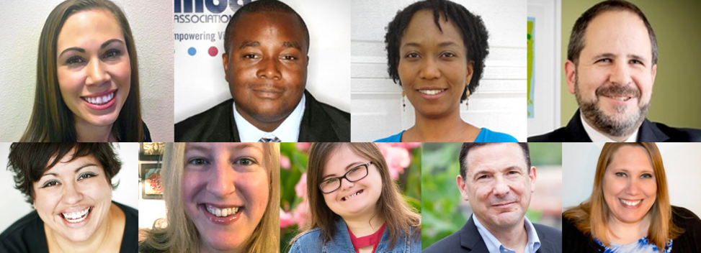

For More ABLE Account Owners Stories: ablenrc.org/able-ambassadors

Slide 38
Help Spread the Word!
Please share information about ABLE accounts with friends, family and community groups including BIPOC!
To receive up-to-date information on ABLE, please subscribe to our AchievABLE newsletter.
Connect with us on social media: Facebook and Twitter.
For answers to all of your questions, visit our website: ablenrc.org and check out our Frequently Asked Questions page at: ablenrc.org/frequently-asked-questions/

